Slide 1
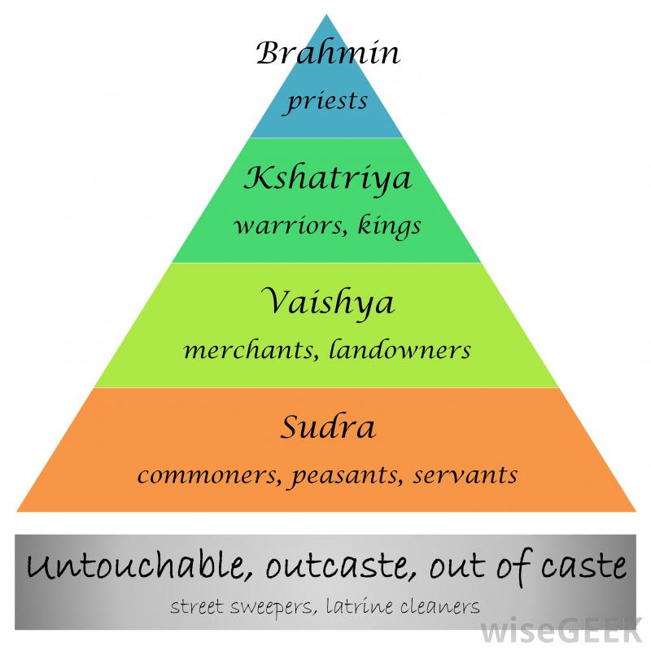
Urban Life and the Caste System
Began the use of weighted coins for trade
Many found success in the cities, but others did not
Urban life reinforced the caste system
Created a new class of people, the “Untouchables”

Slide 2
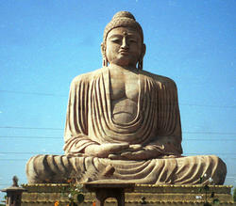
Gautama
Gautama was born in India around 556 B.C.E.
Renounced worldly possessions at the age of 29
Known as Buddha, or Enlightened One
Promoted the middle path

Slide 3
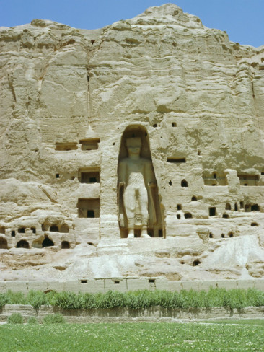
Spread of Buddhism
Buddhists monks used the trade routes to spread their word
Spread north and east into China and the Iranian Plateau
Reached Afghanistan in the 5th century C.E.

Slide 4
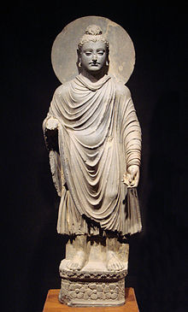
Principles of Buddhism
All life is suffering, or dukkha
The source of suffering is desire
To end all suffering one must be free of desire
Actions, thought and understanding are the path to end all suffering

Slide 5
Principles of Buddhism
Through good deeds one can achieve samsara, or rebirth
Karma of good/bad deeds affects rebirth
Goal should be to reach nirvana, or complete liberation and enlightenment
Life is a journey and death is a return to the earth
The soul, or atman, moves from 1 body to the next at rebirth

Slide 6
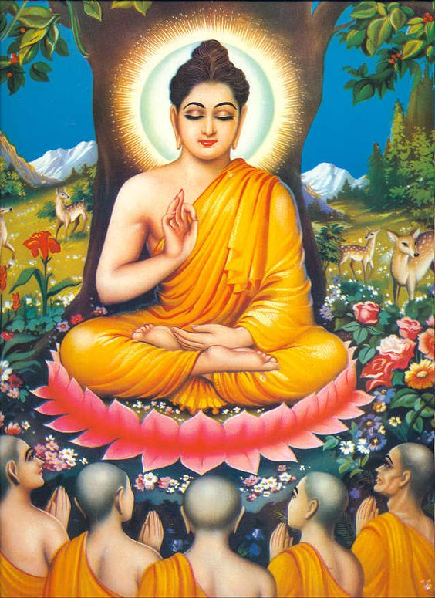
Buddhism Today
About 360 million followers worldwide
Primary followers are in China and southeast Asia
4th largest religion in the world
Modern influences have led to new variations

Slide 7
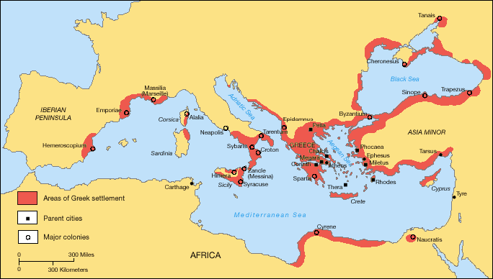
The Mediterranean World
By the 9th century B.C.E. new social and political ideas began to emerge
By the 8th century B.C.E. the population began to rebound
By the 6th century B.C.E. the polis, or city-state became the political center of Greek life

Slide 8
The City – State
Viewed as an extension of the family unit
Free adult males could hold public office, vote and debate public policy
Adult freeborn males held full citizenship and decided public policy, public works and warfare
They were competitive with each other

Slide 9
The City - State
Developed open markets
By 400 B.C.E. a coinage system was created for the exchange of goods
The Agora, or marketplace, was the center of the city – state
Commerce led to the exchange of ideas and the establishment of colonies by the Greeks

Slide 10
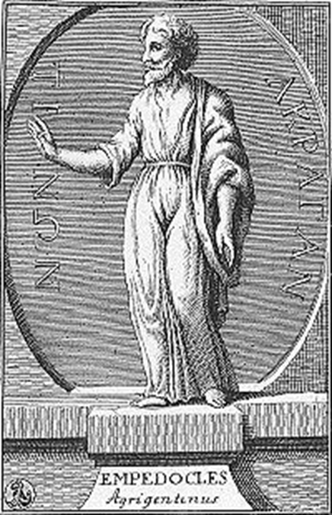
Greek Philosophy
Thales introduced rational investigation of the universe and nature
Xenophanes believed humans viewed gods in the same image as themselves
Thucydides analyzed and explained events in agnostic terms
Used reason to explain how the world around humans worked

Slide 11
Greek Philosophy
Anaximander viewed the basic elements of existence as undefined and limitless
Heraclitus stated, “all is motion”
Empedocles believed the world was made of four (4) elements; beginning of the theory of atoms
Leucippus expanded the theory of atoms by claiming size and arrangements of atoms

Slide 12
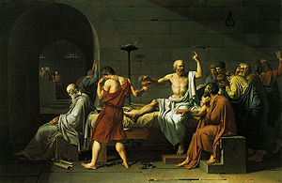
Socrates – (469 – 399 B.C.E.)
Believed reason could explain the truth and knowledge of human affairs
Determined that most citizens possessed little knowledge of basic principles of human nature
Believed that government was necessary, but it was the duty of all citizens to question it as an act of individualism

Slide 13
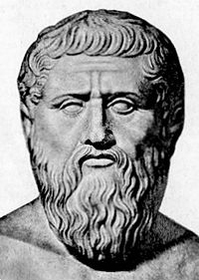
Plato – (429 – 347 B.C.E.)
A student of Socrates
Considered to be the first systematic philosopher and the first to examine political ideas through philosophy
Founded the Academy, a school philosophical investigation in Athens in 386 B.C.E.
Believed moral and political reforms were needed to solve issues of class and state

Slide 14
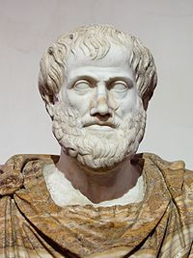
Aristotle – (384 – 322 B.C.E.)
A student of Plato
Established the Lyceum, a school for the gathering, ordering and analysis of all human knowledge, in Athens in 336 B.C.E.
Compiled collections on subjects ranging from astronomy and biology to ethics and rhetoric and applied reason to each to find discrepancies

Slide 15
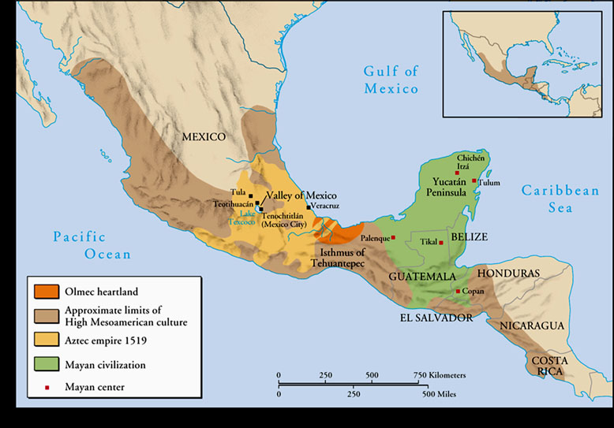
Early Civilizations of the Americas
The Olmec established its culture around 1500 B.C.E.
Around 1400 B.C.E. the Chavin culture emerged on the west coast of modern-day Peru
Mayan city-states began to rise around 750 B.C.E.

Slide 16
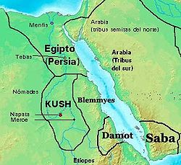
Kush Kingdom
One of the earliest civilization along the Nile River Valley
Kush Kingdom was established around 2000 B.C.E.
The Kingdom reached its peak between 1700 – 1500 B.C.E.
Conquered by Egypt around 1500 B.C.E.

Slide 17
Kush Resurgence
Kush Kingdom began a resurgence with the conquest of Nubia in 900 B.C.E.
Napata was made the capital
In 727 B.C.E. Piye invaded Egypt establishing the 25th Dynasty
Kush were driven out of Egypt by the Assyrians in 656 B.C.E.

Slide 18
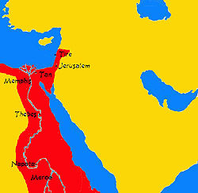
The Kush in Egypt
Capital moved to Meroe in 591 B.C.E. after Egyptians sack Napata
Kingdom became isolated and declined
The Kush were conquered by the Aksumites of Ethiopia in 330 C.E.

